Slide 1
Applied Data Science Capstone Project
The Severity of Car Accidents

Slide 2
Introduction
According to WHO (World Health Organization):
“Every year the lives of approximately 1.35 million people are
cut short as a result of a road traffic crash. Between 20 and 50
million more people suffer non-fatal injuries, with many
incurring a disability as a result of their injury.”
So, This project aims to predict how severity of accidents can be
reduced based on some factors.This project will be based on
Settle city(a seaport city on the West Coast of the United States
and The largest city in both the state of Washington and the
Pacific Northwest region of North America) data

Slide 3
DATA:
Collision data had been fetched from Seattle Department of Transportation
Open Data Program in CSV format.
The dataset has 37 features and The dataset has total observations of 194673 with variation in number of observations for every feature.

Slide 4
Methodology
I will take every feature alone and start to analyze its values by total as I will make for every feature, except ‘SEVERITYCODE’, three data frames one for has the total of repeated times for each value in both types of accident 1 and 2. Then I will make another one for the type 1 and one for type 2.
After that, I analyze the results of each data frame of each feature.

Slide 5
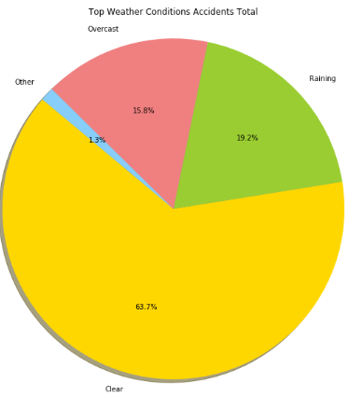
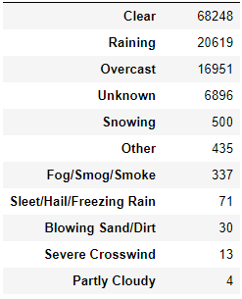
Weather:
The Total:
Below there is a data frame that has the count of every condition accident and a pie chart of its top elements.

Slide 6
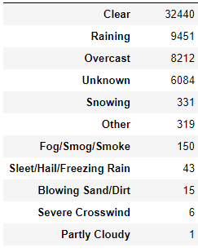
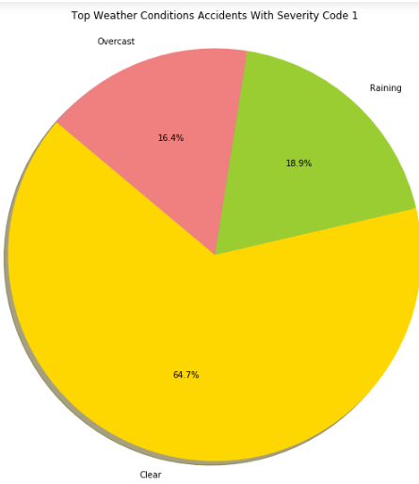
Weather with The 1 severity code count:

Slide 7
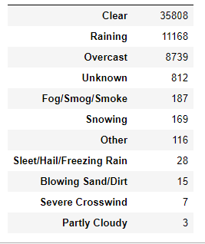
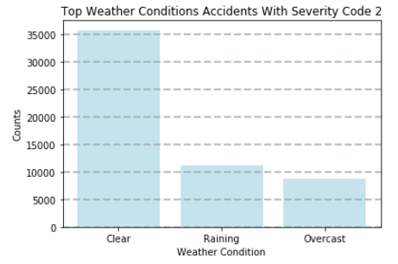
Weather with The 2 severity code count:

Slide 8
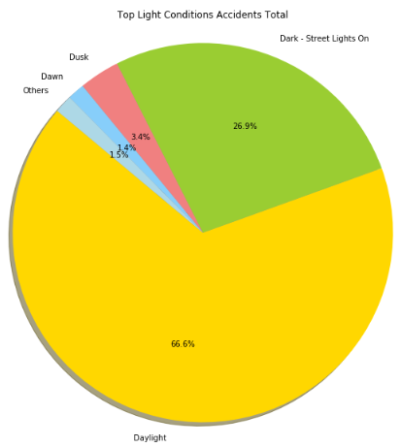
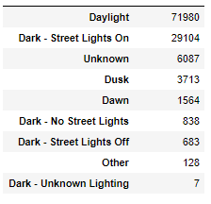
The light conditions
The total:
Below there are :
A data frame has the total number of accidents occured in every light condition.
A pie chart shows the percentages of top conditions.

Slide 9
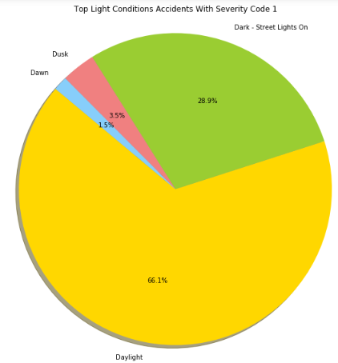
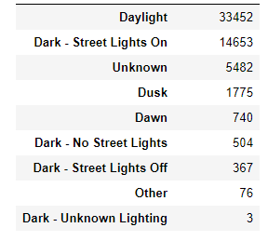
Light with The 1 severity code count:

Slide 10
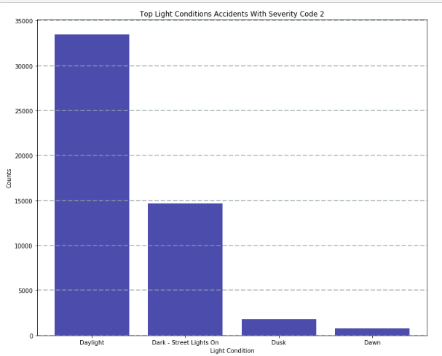
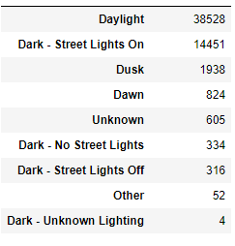
Light with The 2 severity code count:

Slide 11
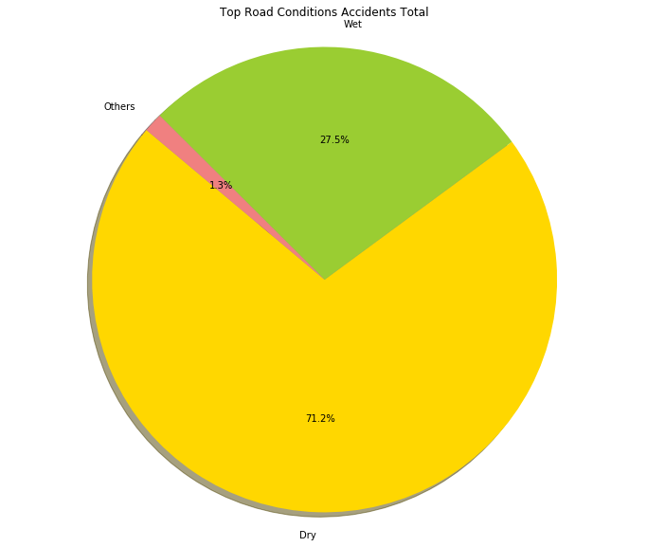
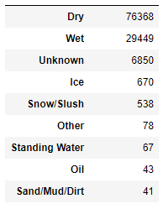
Road
A data frame has the total number of accidents occured in every light condition.
A pie chart shows the percentages of top conditions.

Slide 12
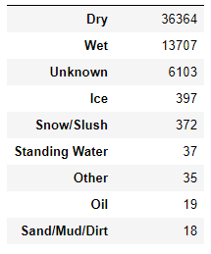
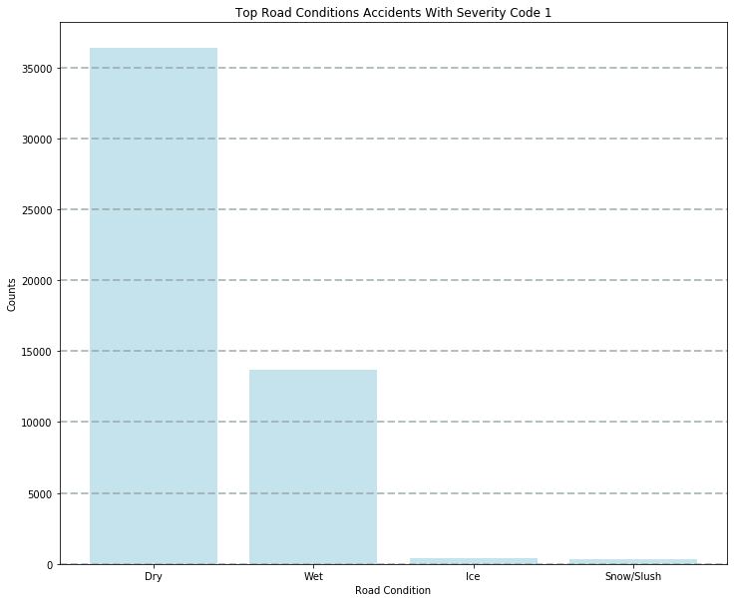
Road with The 1 severity code count:

Slide 13
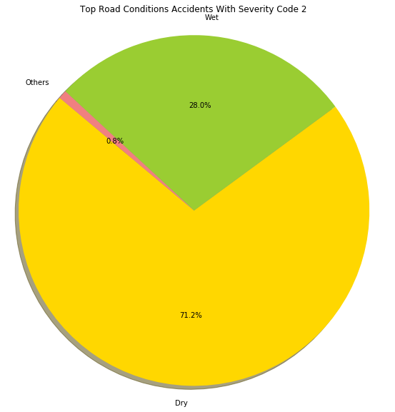
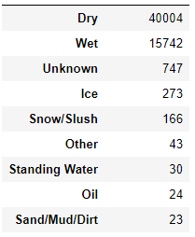
Road with The 1 severity code count:

Slide 14
Results:
Weather:
The probability of 2 is higher
in:
Clear: 4.9%
Raining:8.3%
Overcast :3.1%
Fog/Smog/Smoke:10.9%
The probability of 1 is higher
in:
Snowing: 32.4%
Sleet/Hail/Freezing Rain:21.1%

Slide 15
2.Light:
The probability of 2 is higher
in:
Dawn:5.4%
Daylight:7%
Dusk: 4.4%
The probability of 1 is higher
in:
Streets-Lights on:0.8%
Streets-Lights off:7.4%
No Streets Lights: 20.3%

Slide 16
3.Road:
The probability of 2 is higher
in:
Dry:4.8%
Oil:11.6%
Wet:6.9%
Sand/Mud/Dirt:12.2%
The probability of 1 is higher
in:
Ice: 18.5%
Snow/Slush:38.3%
Standing Water: 10.4%

